Slide 1
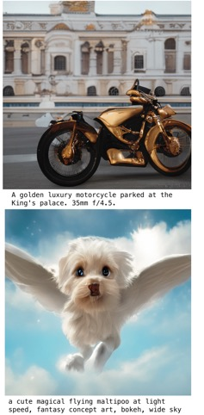
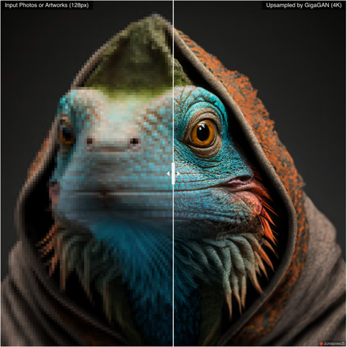
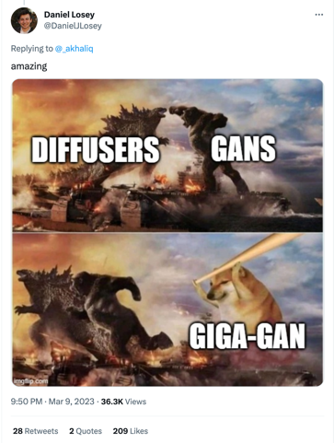
GigaGAN: scaling up GANs for text-to-image synthesis
Minguk Kang, Jun-Yan Zhu, Richard Zhang, Jaesik Park, Eli Shechtman, Sylvain Paris, Taesung Park
POSTECH, CMU, Adobe Research

Slide 2
GigaGAN: Scaling up GANs for text-to-image synthesis
StyleGAN2 (2019, crashed)
DALL-E 2
Part-i transformer in smaller sizes
GigaGAN
Imagen
Part-i transformer (largest model)

Slide 3
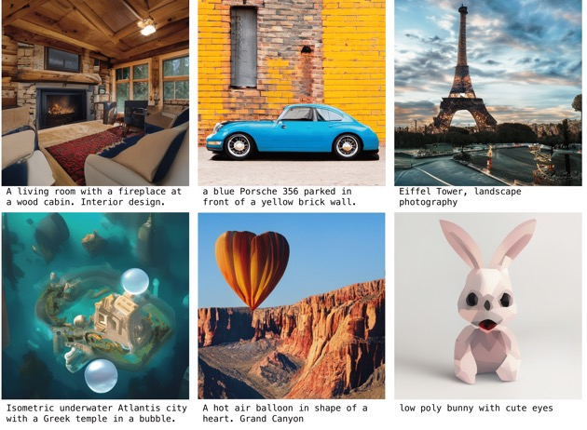
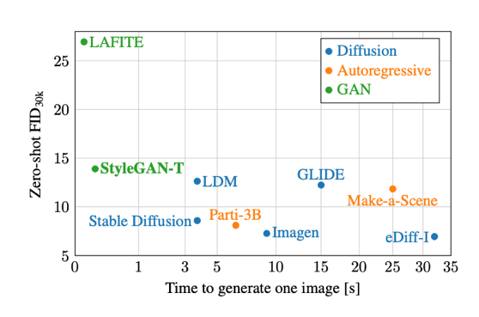
GigaGAN: Scaling up GANs for text-to-image synthesis
GigaGAN
plot from StyleGAN-T (Sauer et al., 2023)

Slide 4
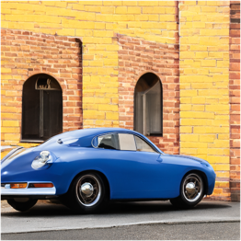
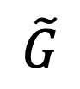
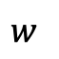
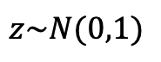
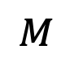
Let’s start with a StyleGAN2 architecture
Convolutional
Synthesis Network
Constant
$$\tilde{G}$$
$$M$$
output
$$z\sim N(0,1)$$
$$w$$
style modulation
Latent code
Mapping Network
StyleGAN2. Karras et al., 2019

Slide 5

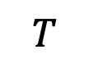
Now add text conditioning
Pretrained text encoder
Learned text encoder
Convolutional
“a blue Porsche 365 parked in front of a yellow brick wall”
CLIP
$$T$$
Constant
$$\tilde{G}$$
$$M$$
output
$$z\sim N(0,1)$$
$$w$$
Latent code

Slide 6
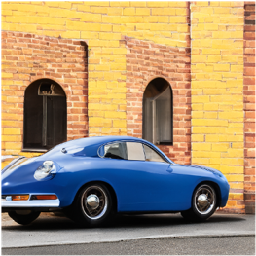
Now add attention
Pretrained text encoder
Learned text encoder
Convolutional
Self-attention
Cross-attention
“a blue Porsche 365 parked in front of a yellow brick wall”
CLIP
$$T$$
Constant
$$\tilde{G}$$
$$M$$
output
$$z\sim N(0,1)$$
$$w$$
Latent code

Slide 7
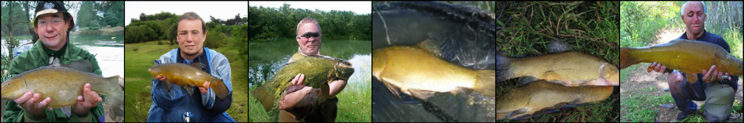
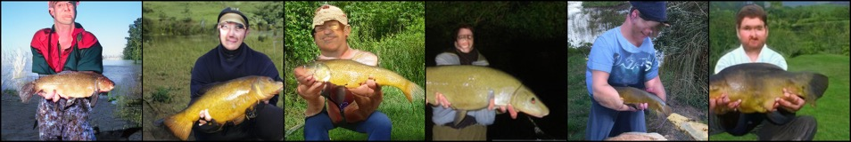
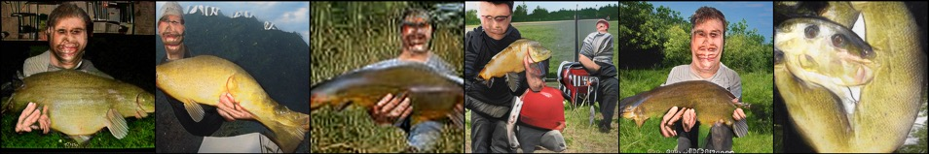
Convolutional GANs are not good at creating good structure
ADM-G-U
diffusion models
LDM-4-G
StyleGAN-XL
results on ImageNet for class 0 (tench)

Slide 8
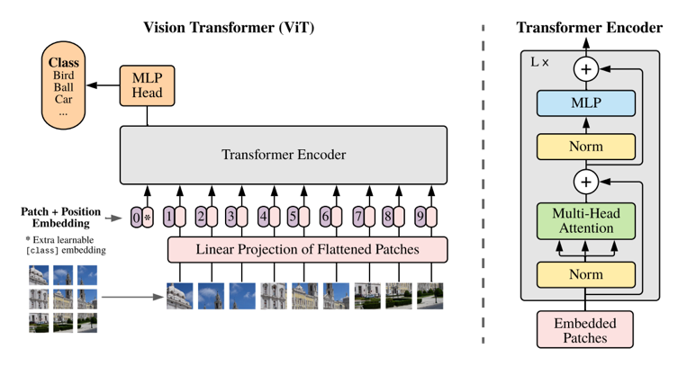
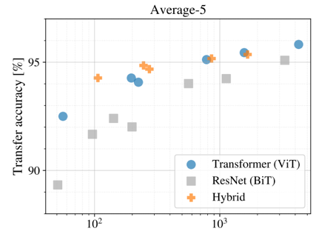
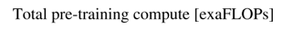
Impact of attention is proven
Vision Transformer (ViT), Dosovitskiy et al., 2021

Slide 9
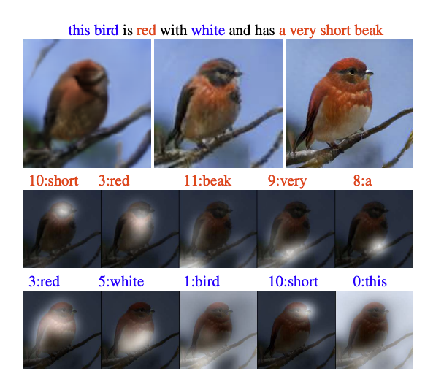
Attention was already used in AttnGAN
AttnGAN: Fine-Grained Text to Image Generation with Attentional Generative Adversarial Networks
Tao Xu et al., CVPR 2018

Slide 10
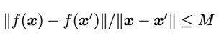
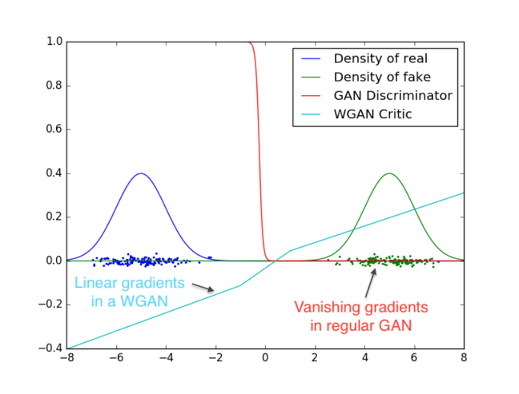
But be careful. Lipschitz continuity is important in GAN training
should be bounded.
i.e. the function $f$ must be Lipschitz continuous
WGAN-GP (Gulrajani etl a., 2017)
Spectral Norm (Miyato et al., 2018)

Slide 11
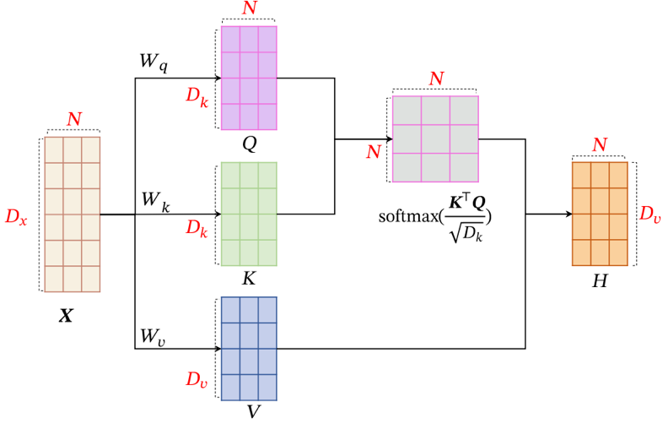
QK Dot-product attention breaks Lipschitz Continuity
The nonlinear softmax operation is not Lipschitz bounded, because the Jacobian arbitrarily scales with the input variance.
Kim et al., The Lipschitz constant of self-attention. ICML 2021. Figure from https://www.cnblogs.com/hbuwyg/p/16978264.html

Slide 12
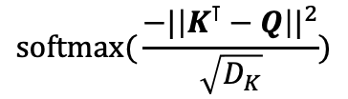
L2-distance attention maintains Lipschitz Continuity
$$\text{softmax}\text{(}\frac{{−|\left|K^{⊺}−Q\right||}^{2}}{\sqrt{D_{K}}})$$
If L2 distance is used instead of the dot product, the attention becomes Lipschitz! (Proof in Kim et al., ICML 2021)
Kim et al., The Lipschitz constant of self-attention. ICML 2021. Figure from https://www.cnblogs.com/hbuwyg/p/16978264.html

Slide 13
Now add the L2 attention
Pretrained text encoder
Learned text encoder
Convolutional
L2 Self-attention
L2 Cross-attention
“a blue Porsche 365 parked in front of a yellow brick wall”
CLIP
$$T$$
Constant
$$\tilde{G}$$
$$M$$
output
$$z\sim N(0,1)$$
$$w$$
Latent code

Slide 14
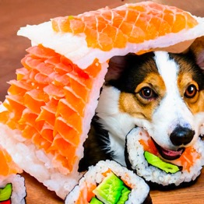
GigaGAN: Scaling up GANs for text-to-image synthesis
Pretrained text encoder
Learned text encoder
Convolutional
Self-attention
Cross-attention
“a cute corgi lives in a house made out of sushi”
CLIP
$$T$$
Constant
$$\tilde{G}$$
$$M$$
output
$$z\sim N(0,1)$$
$$w$$
Latent code

Slide 15
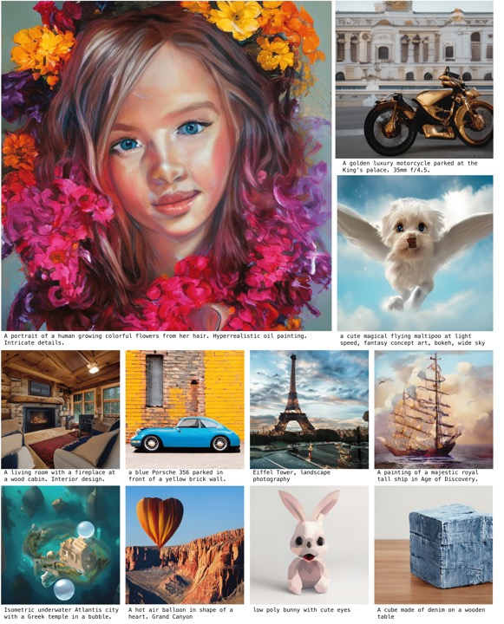
GigaGAN
figure from StyleGAN-T
GigaGAN
GigaGAN

Slide 16
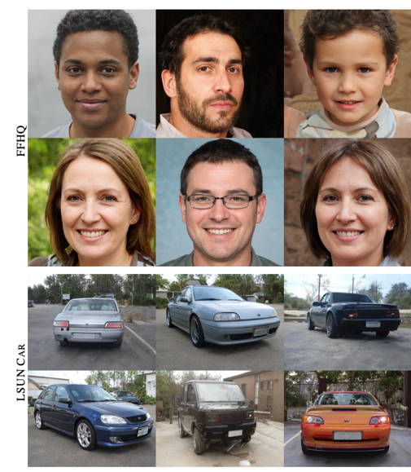
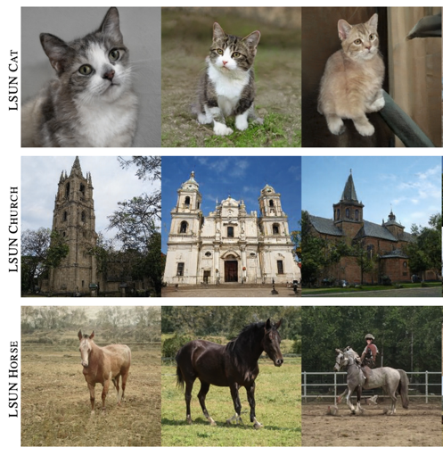
Sample adaptive kernel selection (motivation)
StyleGAN2 is already good if trained on a single class, why don’t we try an ensemble of many models?
Notes:
Let’s move to the next technical contribution.

Slide 17
Sample adaptive kernel selection
w
Affine
Affine
Softmax
Weighted-Avg
Filter Bank
Selected Filter
Modulated
weights
Filter Selection
Modulation

Slide 18
Sample adaptive kernel selection
Pretrained text encoder
Learned text encoder
Convolutional
L2 Self-attention
L2 Cross-attention
“a blue Porsche 365 parked in front of a yellow brick wall”
CLIP
$$T$$
Constant
$$\tilde{G}$$
$$M$$
output
$$z\sim N(0,1)$$
$$w$$
Latent code
Sample-adaptive kernel selection

Slide 19

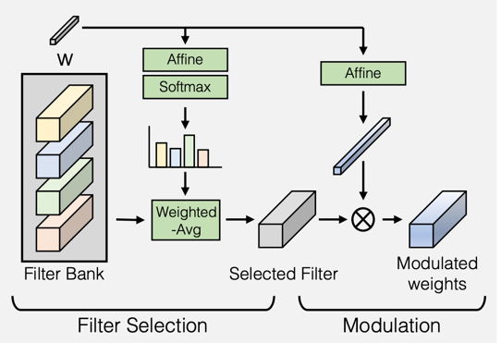
Sample adaptive kernel selection
resolution-independent
Complexity of convolution operation scales with feature width and height
Sample-adaptive kernel selection decouples model capacity from resolution

Slide 20
Adaptive Convolution
w
Affine
conv weights
style vec
modulated weights
tatoo
pointy nose
blond hair
C
…
Visualizing the style-modulation of StyleGAN2. It’s as if conv filters are “chosen” by the w-vector.

Slide 21
Adaptive Convolution
w
w
Affine
Affine
M-dim style vec
style vec
modulated weights
outdoor
people
Disney characters
C
C
softmax over M
adaptively selected conv filter
M
Bank of Convolutional Filters
computational overhead: CM + HWC²
(The left hand side is performed only once. the right hand side is repeated at all locations)

Slide 22

Leveraging conditioning with CLIP loss
z
z
¨
real/ fake
CLIP text embedding
CLIP
CLIP image embedding
CLIP loss
CLIP loss is possible thanks to the advantage of GAN training: the final output images are generated during training.

Slide 23
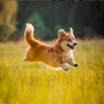
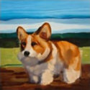
Discriminate fake pairs
“a picture of a corgi”
z
real
“a picture of a corgi”
z
fake
“a car in a parking lot”
z
also fake
See also: StackGAN. Zhang et al., 2017

Slide 24
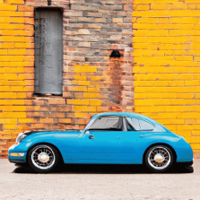
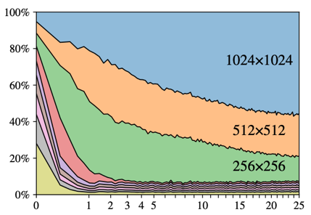
Multi-scale Generator of StyleGAN2
$$\tilde{G}$$
sum
contribution of each layer of StyleGAN2 during the course of training
multi-scale output

Slide 25

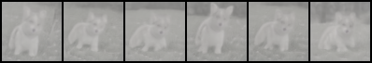
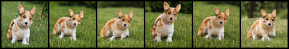



Multi-scale Generator of StyleGAN2
Block64-0
Block64-1
$$\tilde{G}$$
Block64-2
Block32-0
Block32-1
Block32-2

Slide 26

Multi-scale Generator of StyleGAN2
Block64-0
Block64-1
$$\tilde{G}$$
Block64-2
Block32-0
Block32-1
Block32-2
contribution of each layer of StyleGAN2 during the course of training

Slide 27
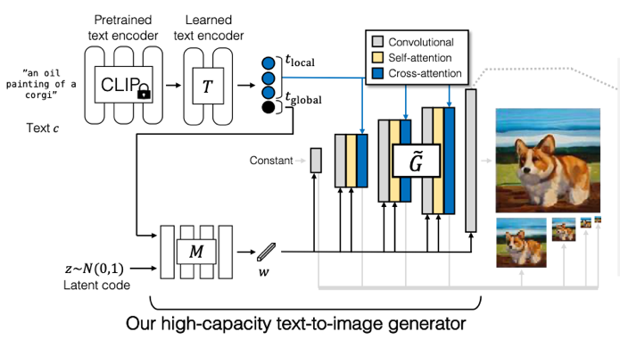
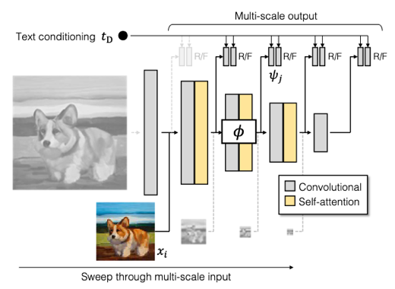
Multi-scale input, multi-scale output adversarial loss
Generator outputs an image pyramid
Discriminator makes independent decision, one per every input-output scale.
Notes:
discriminator doesn’t become so slow, because it’s like mipmap. Majority of computation is done at high res layer, but we don’t have many of those.

Slide 28
StyleGAN2 tends to synthesize images at the very last moment.
Block32-0
Block64-0
Block32-1
Block64-1
Block32-2
Block64-2
<Images at 32 resolution>
<Images at 64 resolution>
$⟹$ Intermediate images contribute very little to the final outputs.

Slide 29
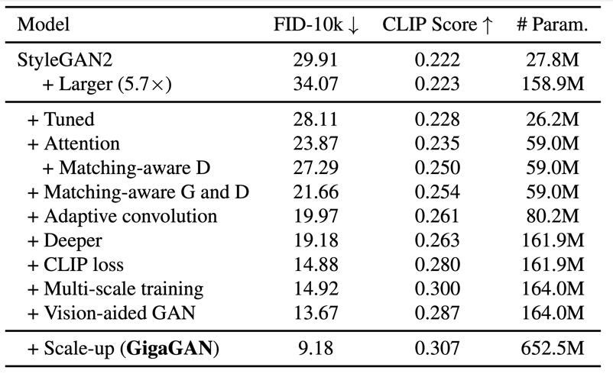
All contributions add up

Slide 30
GigaGAN: Scaling up GANs for text-to-image synthesis
StyleGAN2 (crashed)
DALL-E 2
Part-i transformer in smaller sizes
GigaGAN
Imagen
Part-i transformer (largest model)

Slide 31
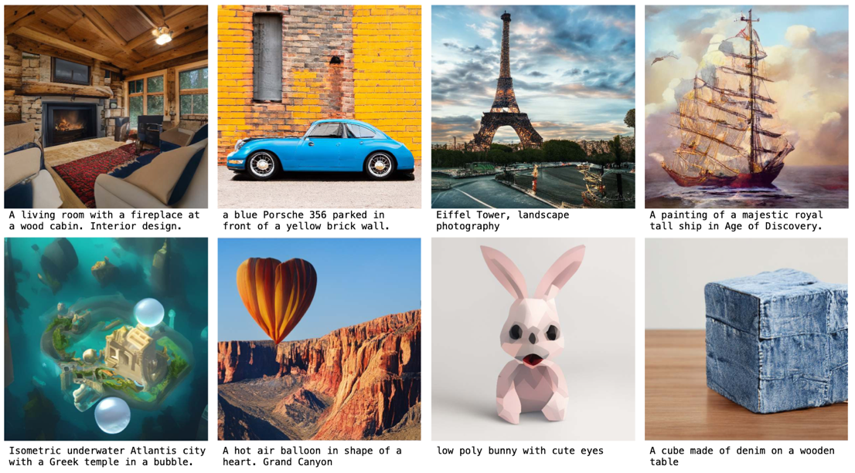
Text-to-Image results

Slide 32
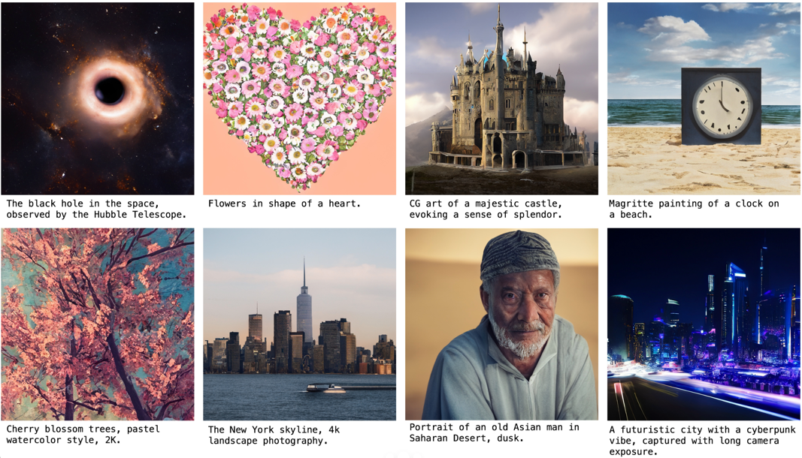
Text-to-Image results

Slide 33
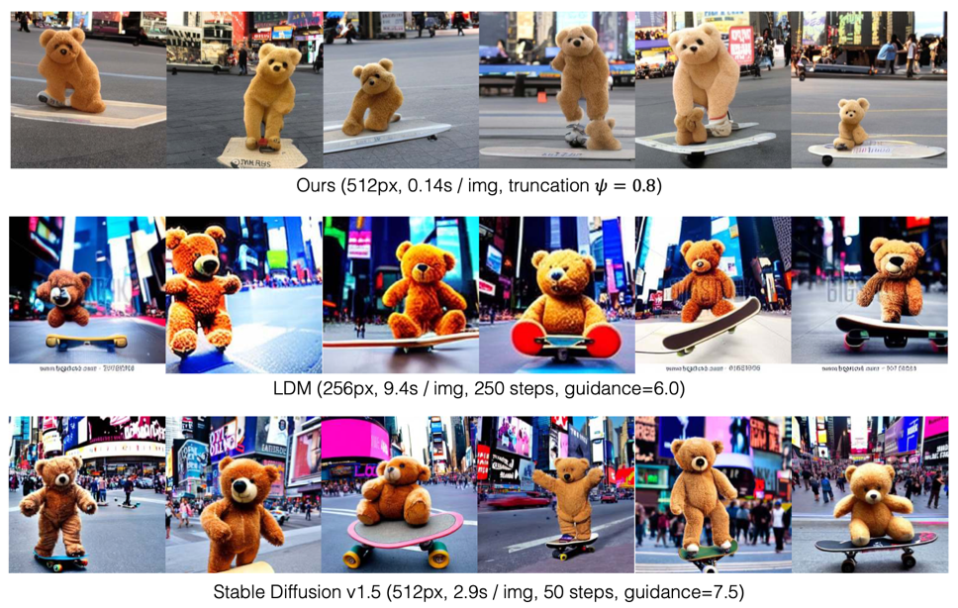
still has some issues

Slide 34
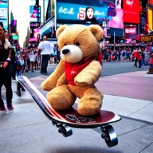
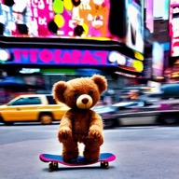
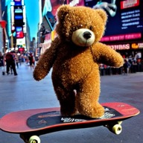
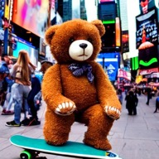
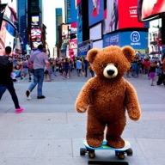
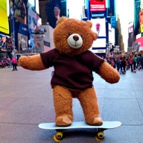
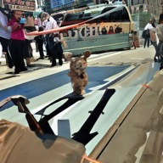
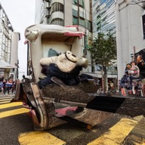
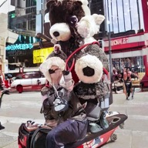
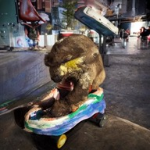


Classifier-Free Guidance behind the success of Diffusion Models
Stable Diffusion v1.5 with guidance=7.5
Stable Diffusion v1.5 with guidance=1.0

Slide 35




Classifier-Free Guidance behind the success of Diffusion Models
guid= 7.5
guid=1
guid= 2.0
guid=7.5
guid=2.0
guid= 1.0

Slide 36

training amount
sample quality
model size
speed

Slide 37

Failure cases (poor generation results)

Slide 38
guidance=1
guidance=7.5
guidance=2

Slide 39

Classifier-Free Guidance behind the success of Diffusion Models

Slide 40

Disentangled style control with text prompt

Slide 41






Disentangled style control with text prompt
“a cube on tabletop”
CLIP
$$T$$
Pretrained text encoder
Learned text encoder
Constant
$$\tilde{G}$$
$$M$$
$$z\sim N(0,1)$$
$$w$$
Latent code

Slide 42






Disentangled style control with text prompt
Pretrained text encoder
Learned text encoder
“a cube on tabletop”
CLIP
$$T$$
Constant
$$\tilde{G}$$
$$M$$
$$z\sim N(0,1)$$
$$w$$
Latent code

Slide 43

Disentangled style control with text prompt
Pretrained text encoder
Learned text encoder
“a cube on tabletop with the texture of denim”
CLIP
$$T$$
Constant
$$\tilde{G}$$
$$M$$
$$z\sim N(0,1)$$
$$w$$
Latent code

Slide 44

Disentangled style control with text prompt
Pretrained text encoder
Learned text encoder
“a cube on tabletop with the texture of denim”
“a cube on tabletop”
“a cube on tabletop”
“a cube on tabletop with the texture of denim”
CLIP
$$T$$
Constant
$$\tilde{G}$$
$$M$$
$$z\sim N(0,1)$$
$$w$$
Latent code

Slide 45

Prompt Interpolation

Slide 46


Interpolation video

Slide 47

Image-based coarse-to-fine style swapping

Slide 48
Upscaler

Slide 49








Step 1: Text
Encoder
Step 2: Diffusion
Model
Step 3:
GAN
Upsampler
high res image
text prompt
low res image
A corgi lives in a house made out of sushi
The more steps you take, the better the quality becomes
… and it becomes slower and more expensive

Slide 50

Step 1: Text
Encoder
Step 2: Diffusion
Model
Step 3:
GAN
Upsampler
high res image
text prompt
low res image
A corgi lives in a house made out of sushi
a realistic or a fake image?
GAN Upsampler
Discriminator
GigaGAN

Slide 51

Architecture
Pretrained text encoder
Learned text encoder
Convolutional
Self-attention
Cross-attention
“a cute corgi lives in a house made out of sushi”
T5
$$T$$
$$\tilde{G}$$
low-res input
$$M$$
upscaled output
$$z\sim N(0,1)$$
$$w$$
Latent code
+ LPIPS loss is used

Slide 52



Input (128px)
Our GigaGAN (1024px, 0.13sec/image)
Stable Diffusion (7.75sec/image)

Slide 53



Input (128px)
Our GigaGAN (1024px, 0.13sec/image)
Stable Diffusion (7.75sec/image)

Slide 54



Input (128px)
Our GigaGAN (1024px, 0.13sec/image)
Stable Diffusion (7.75sec/image)

Slide 55



Input (128px)
Our GigaGAN (1024px, 0.13sec/image)
RealESRGAN (0.06sec/image)

Slide 56



Input (128px)
Our GigaGAN (1024px, 0.13sec/image)
RealESRGAN (0.06sec/image)

Slide 57


